Slide 1


Bank of Baroda Hackathon - 2022
Technology Partner
Your Team Name : Team Zeus
Your team bio :1)Om Khade
2)Prathamesh Bagade
3)Onkar Mane
4)Tanay Kohle
Date :-
Date :

Slide 2
Problem Statement
Bank handles large volumes of cheques and other financial documents in the clearing process. The process involves many technical verifications including signature verification. Some of these steps are manual and require human intervention to complete the process. The current process requires the high human capital deployment and longer processing time. Our solution targets this pain point and decreases human intervision to bare minimum.
1)Om Khade
2)Prathamesh Bagade
3)Onkar Mane
4)Tanay Kohjvfj

Slide 3
User Segment & Pain Points
Which user /advertiser segment would be early adopter of your product & why?
Banks Can Use the Cheque Processing Application to quickly process batch of cheques.
Automated Signature Verification based on the dissimilarity of the signature compared to signature in database
Unified Dashboard to view processed cheque count, Truncated Cheques and KPIs.
Improve the efficiency of cheque amount encoding whilst reducing effort and costs
Multilingual Support - Application is able to process cheque of various languages including but not limited to Hindi, English, Marathi.

Slide 4
Azure tools or resources
Azure computer vision API for OCR(optical Character Recognition).
Azure App Service for application deployment

Slide 5
Prerequisite
Following are some of the alternatives products for Automated Cheque Processing.
CPS – Cheque Processing System by PTL
Smart Cheque Entry by PT MURNI SOLUSINDO NUSANTARA
CUSTOMER-FRIENDLY - CHECK PROCESSING by aperta
Cheque Processing Automation by Feat Systems.
Automated Inward Cheque Processing by Arya.ai
Intelligent Cheque Clearing System - Cube-IQ
Inward Cheque Processing

Slide 6
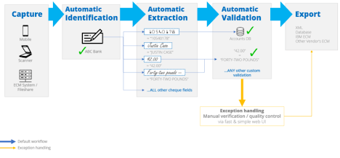
Any Supporting Functional Documents
Present your solution, talk about methodology, architecture & scalability
Customer/Branch user uploads the cheque and data into the Mobile application
Now the OCR comes into action to extract data from the uploaded documents
Extracted data is validated using the bank database. Siamese Network is used to verify signature.
Customer/Branch user then gets a confidence scorecard from the AI-Engine based on signature, minimum account balance and date.
He Approves/Reject case after checking the same
on the Screen
Resulting, completion of the transaction was
a successful
Supporting Documents Link:-
https://www.researchgate.net/figure/Main-steps-involved-in-automatic-bank-cheque-processing_fig3_226705617
https://www.jetir.org/papers/JETIR2107218.pdf

Slide 7
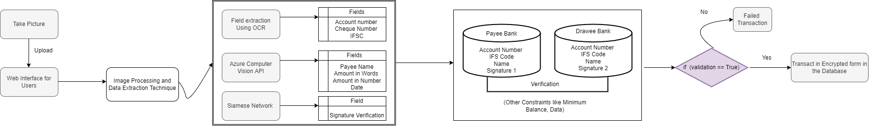
Key Differentiators & Adoption Plan
Various Models used in the Cheque Processing Application will be made into microservices and will be hosted on cloud to minimise processing time and improve scalability.
Multilingual support available.
False Positive and False Negatives of the Sign verification will be used to retrain the Siamese Network to increase the efficiency of the model.
Workflow of Cheque Processing System

Slide 8
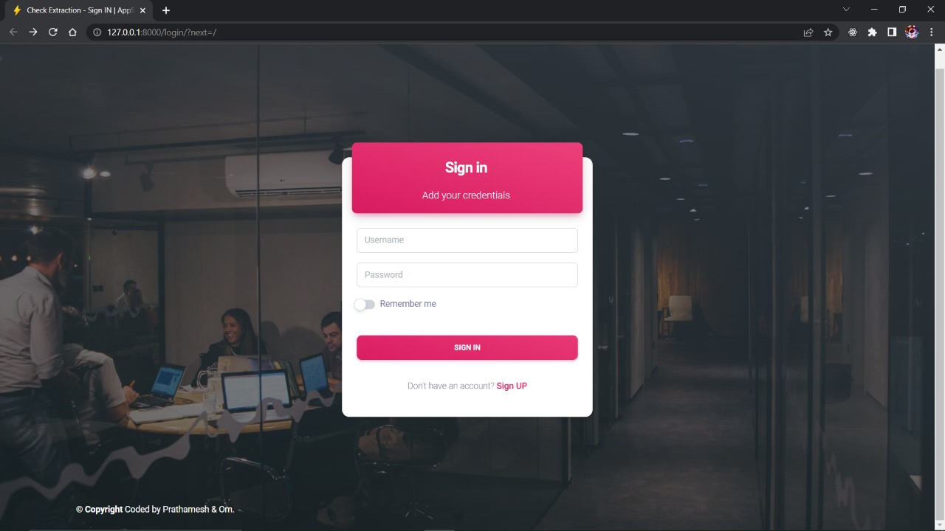
GitHub Repository Link: https://github.com/khadeom/Bank-of-Baroda-Hackthon

Slide 9
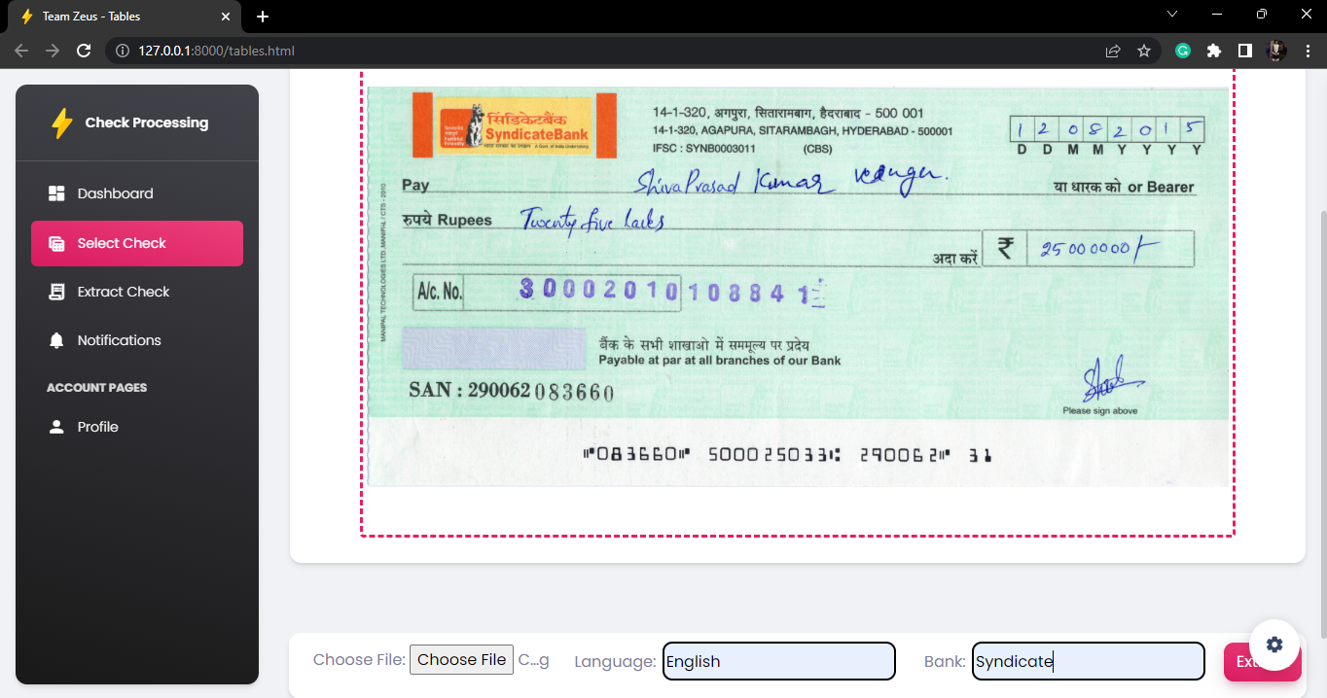
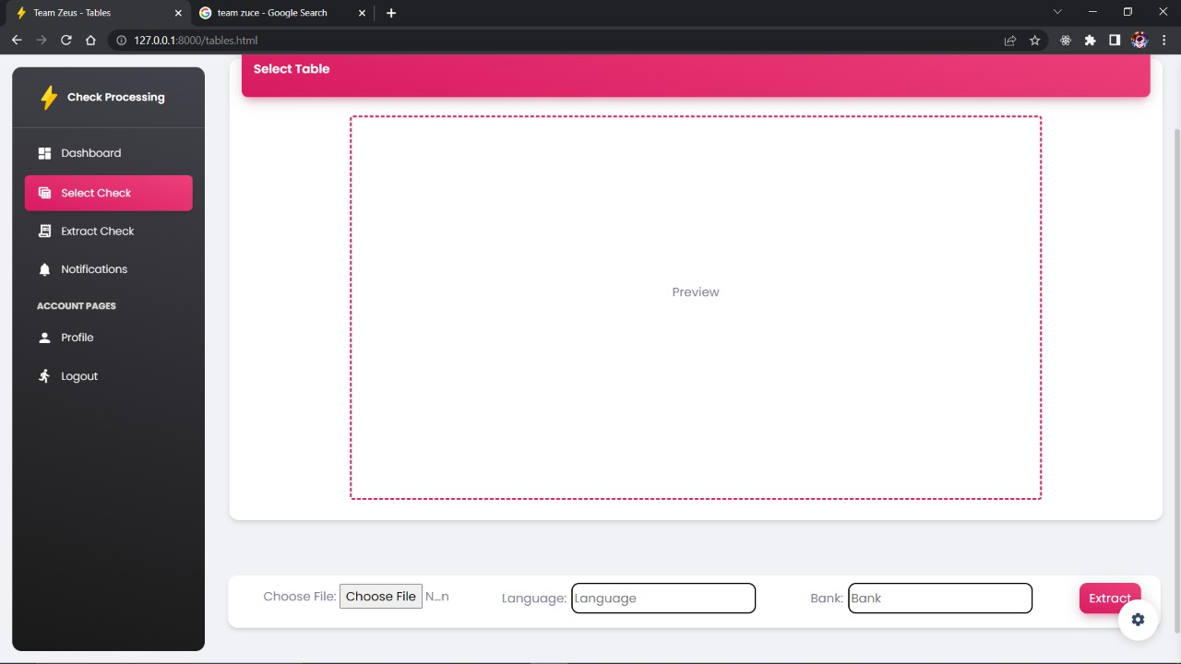
Screenshots:

Slide 10
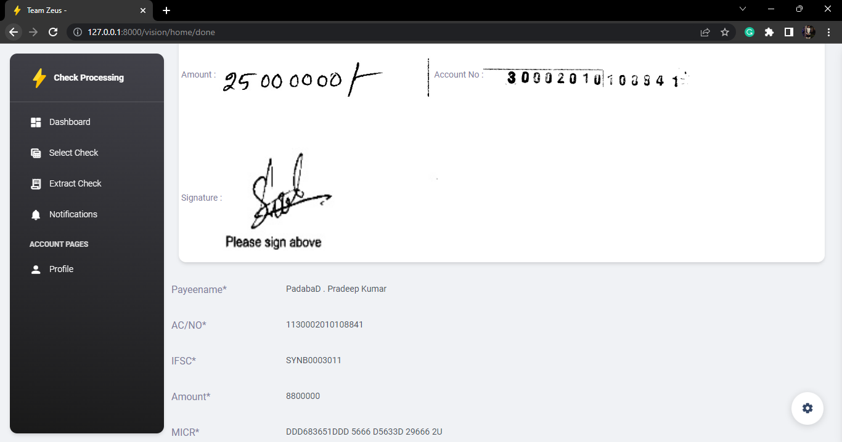

Slide 11
Thank You
1)Om Khade
2)Prathamesh Bagade
3)Onkar Mane
4)Tanay Kohle

